Slide 1
An Analysis on Movie Dataset CS 643: Cloud Computing (Group Project) Instructor: Prof.Cristian Borcea TA: Nafize Paiker
Group Members:
Priyam Patel (Ucid : pp577@njit.edu)
Akshay Jaitly (Ucid : aj455@njit.edu)
Palash Bhatia (Ucid : pab39@njit.edu)
Abhishek Shirke (Ucid : ajs235@njit.edu)

Slide 2
Idea Motivation:
Idea:
To efficiently analyze and derive meaningful results from movie dataset using Hadoop MapReduce.
Motivation:
To generate a detailed analysis which will benefit movie streaming companies and production houses with targeting audiences, generating revenue, and more.

Slide 3
Overview:
Input Dataset: Contain 1,000,209 anonymous ratings of approximately 3,900 movies made by 6,040 users. It is a combination of 3 sets
Rating File Description: All ratings are contained in the file "ratings.dat" and are in the following format.
UserID::MovieID::Rating::Timestamp
UserIDs range between 1 and 6040
MovieIDs range between 1 and 3952
Ratings are made on a 5-star scale
Each user has at least 20 ratings
Users File Description: User information is in the file "users.dat" and is in the following format.
UserID::Gender::Age::Occupation::Zip-code
Gender is denoted by a "M" for male and "F" for female
Age is chosen from the following ranges: 1: Under 18, 18: 18-24, 25: 25-34, 35: 35-44, 45:45-49
50: 50-55, 56: 56+.

Slide 4
Overview:
Occupation is chosen from the following choices
0: "other", 1: "academic/educator“, 2: "artist“, 3: "clerical/admin“
…17: "technician/engineer“, 18: "tradesman/craftsman“, 19: "unemployed“, 20: "writer“
Movie File Description : Movie information is in the file "movies.dat" and is in the following
Format.
MovieID::Title::Genres
Titles are identical to titles provided by the IMDB (including year of release).
Genres are pipe-separated and are selected from the following genres.
Action, Adventure, Animation, Children’s, Comedy, Documentary, Drama, Fantasy, Film-Noir, Horror, Musical, Mystery, Romance, Sci-Fi, Thriller, War, Western.

Slide 5
Design Workflow:
Cleaning of redundant data
Data in .dat
format
Load Cleansed data into HDFS
Visualize stats using MS Excel
Analyze data using AWS EMR for scalability
Analyze data using Hadoop Mapreduce on EC2(4-node)

Slide 6
Design:
We used multiple data sets for the analysis of various influencing parameters and thus implemented multiple programs.
Loaded clean data onto hdfs.
Programs:
Top Influencers:
Implemented program for finding the users who had rated the most number of movies.
Movie by season:
Find out top movies genres that people were interested to watch during:
Valentines day
Halloween
Christmas

Slide 7
Design:
Programs:
Zip Codes with Average Age:
Find the zip code with the least average age that helps in understanding youth dominated locations.
May help in publicizing youth related movies in that area.
Average Rating Sorted:
Helps in making Charts that display highest ratings by users:
Top 100: 100 block busters movies of all time.
Identify Movies by Genre:
Classification of movies based on a specific genre i.e. type of movies
Thriller | Fantasy | Comedy | Action

Slide 8
Design:
Programs:
Grouping of Users by Age & Gender:
Segregating & Classifying Users based on their Age & Gender to help understand the diversity of the users.
Querying:
Find the genre for a specific movie from the dataset.

Slide 9
Implementation:
Implemented using Hadoop Map Reduce in Java.
Each program consisted of several MapReduce jobs which performed sorting and generating final output on HDFS.
Implemented on several node clusters:
2-node
4-node
8-node
Measured scalability and performance on AWS EMR

Slide 10
Noticeable Analysis:

Slide 11
Noticeable Analysis:

Slide 12
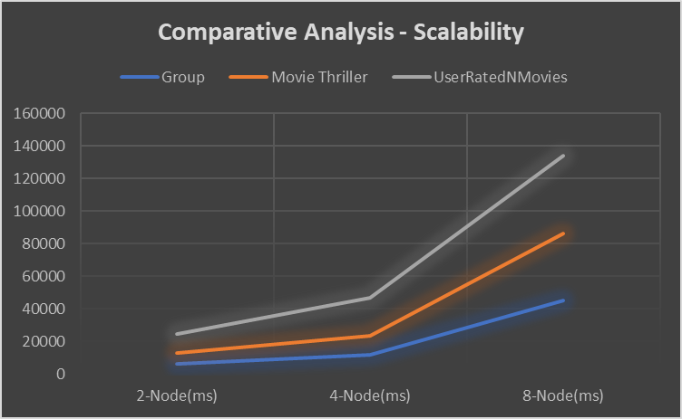
Evaluation: Scalability: Analyzing scalability as a function of cluster size.

Slide 13
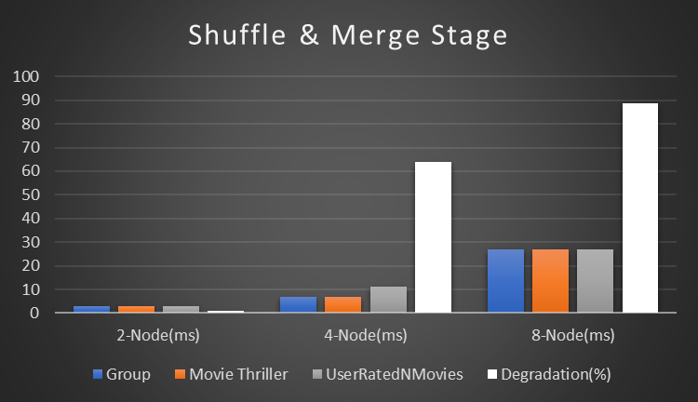
Evaluation: Degradation at Shuffle Task:

Slide 14
Conclusion:
Availability of cloud based infra-structure management helps in faster analysis of key information processing from various datasets.
Map Reduce helps in effective and systematic way to analyze of information in varying aspects such as creating statistics for analysis such as top influencers as well as most popular genres at varying time of the year.
Such vital information is helpful for varying movies based industries such as:
Netflix
Hulu
HBO

Slide 15
Thank You

